Slide 1

Westminster Shorter Catechism
Questions 24 - 26
March 21, 2021
Calvary OPC, La Mirada, CA

Slide 2
Question #24
Q. How doth Christ execute the office of a prophet?
A. Christ executes the office of a prophet, in revealing to us, by his word and Spirit, the will of God for our salvation.

Slide 3
What does the Bible say?
"No man has seen God at any time; the only begotten Son, which is in the bosom of the Father, he has declared him." (John 1:18)
"Which things also we speak, not in words which man's wisdom teaches, but which the Holy Ghost teaches" (1Corinthians 2:13)
"...from a child thou hast known the holy scriptures, which are able to make thee wise unto salvation..." (2Timothy 3:15)

Slide 4
Q. What is a prophet?
Different types of prophets:
a) Those who foretell God's word
b) Those who forthtell the Word of God
c) False prophets (and apostles)
(a) Prophets such as Ezekiel and John foresaw future events
(b) But a prophet also accurately applies God's Word to his situation
the Old Testament prophets applied the Law to their situation
Deuteronomy 28: 11.25.36-37 <=> Jeremiah 22:1-5

Slide 5
False prophets
"For I have not shunned to declare to you the whole counsel of God." (Acts 20:27)
"I found it necessary to write to you exhorting you to contend earnestly for the faith which was once for all delivered to the saints." (Jude 1:3)
Conclusion: the Word of God is complete and we need no new revelation or an extra (gnostic) word from God
"And you have tested those who say they are apostles and are not, and have found them liars" (Revelation 2:2)
The apostles are the foundation of the church (Ephesians 2:20)
Bob Jones, a great 'prophet' in the New Apostolic Reformation
Different apostles, different church, different spirit (Andergeist)

Slide 6
Back to Sola Scriptura
"Then last of all He was seen by me also, as by one born out of due time." (1Corinthians 15:8)
"Love never fails. But whether there are prophecies, they will fail; whether there are tongues, they will cease; whether there is knowledge, it will vanish away. For we know in part and we prophesy in part. But when that which is perfect has come, then that which is in part will be done away." (1Corinthians 13:8-10)
When Christ comes for the second time, prophesy and knowledge shall cease (tongues long before then).

Slide 7
Back to Sola Scriptura
During the Reformation, every man was allowed to interpret the Bible for himself
Now we are going back to a caste of scholars who alone can interpret the Bible
"Assuredly, I say to you, among those born of women there has not risen one greater than John the Baptist; but he who is least in the kingdom of heaven is greater than he." (Matthew 11:11)
We have the fulness of revelation, thus prophecies will have ceased.

Slide 8
Magisterial versus ministerial
The magisterial use of God's Word:
the church can bring new laws
proclaim new revelation
Roman Catholic church
The ministerial use of God's Word:
the church does not make up any new revelation or law
the church only proclaims God's Word
God's Word is clear and self-interpreting
"Be diligent to present yourself approved to God, a worker who does not need to be ashamed, rightly dividing [applying] the word of truth." (2Timothy 2:15)
The Bible makes the church, not the other way around

Slide 9
Question #25
Q. How doth Christ execute the office of a priest?
A. Christ executes the office of a priest, in his once offering up of himself a sacrifice to satisfy divine justice, and reconcile us to God; and in making continual intercession for us.

Slide 10
What does the Bible say?
"Christ was once offered to bear the sins of many." (Hebrews 9:28)
"Therefore, in all things He had to be made like His brethren, that He might be a merciful and faithful High Priest in things pertaining to God, to make propitiation for the sins of the people." (Hebrews 2:17)
"He is able to save them to the uttermost that come unto God by him, seeing he ever liveth to make intercession for them." (Hebrews 7:25)

Slide 11
Some terms
Reconciliation: to make peace between two parties, one of which has been offended (God) by our sins
2Corinthians 5:18-20: God has reconciled us to Himself through the sacrifice of His Son Jesus Christ, and so we also take part in the ministry of reconciling others to God
Expiation: To remove the guilt of sin by paying of a penalty.
Propitiation: To satisfy God's wrath in that He is no longer angry at us, but is at peace with us.

Slide 12
Some more terms
This is what the atonement is all about (at-one-ment)
"whom God set forth as a propitiation by His blood, through faith, to demonstrate His righteousness, because in His forbearance God had passed over the sins that were previously committed" (Romans 3:25)

Slide 13




Slide 14
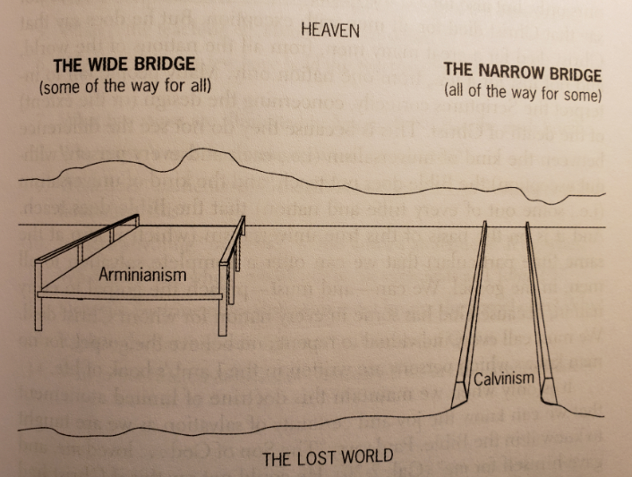
As priest, who did Jesus die for?

Slide 15
All or many?
"I pray for them. I do not pray for the world but for those whom You have given Me, for they are Yours. And all Mine are Yours, and Yours are Mine, and I am glorified in them." (John 17:9-10)
"For even the Son of Man did not come to be served, but to serve, and to give His life a ransom for many." (Mark 10:45)
"I have been crucified with Christ; it is no longer I who live, but Christ lives in me; and the life which I now live in the flesh I live by faith in the Son of God, who loved me and gave Himself for me." (Galatians 2:20)

Slide 16
Particular versus universal atonement
Did Jesus die for the sins of all (even unbelief)? Then all should be saved, because His blood cleans us once and for all (Hebrews 10:10).
Jesus died for you by name: Andrew, Tom, Rebecca, Safa, etc.
Jesus died once and for all, His sacrifice does not have to be repeated (as in the Mass)
It ends all sacrifices (Hebrews 10:3-4)
"So when Jesus had received the sour wine, He said, 'It is finished!' And bowing His head, He gave up His spirit." (John 19:30)

Slide 17
Question #26
Q. How doth Christ execute the office of a king?
A. Christ executes the office of a king, in subduing us to himself, in ruling and defending us, and in restraining and conquering all his and our enemies.

Slide 18
What does the Bible say?
"The people shall be willing in the day of thy power." (Ps. 110:3)
"For the Lord is our judge, the Lord is our lawgiver, the Lord is our king: he will save us." (Isaiah 33:22)
"For he must reign, till he hath put all enemies under his feet" (1Corinthians 15:25)

Slide 19
What is the kingdom of God like?
We have been brought from darkness into the kingdom of God's Son (Colossians 1:23)
It is supernatural, not of this world (John 18:36)
It comes not by 'observation' (Luke 17:20)
we do not know the day or the hour (Matthew 24:36)
Jesus' kingdom will never end (2Peter 1:11)
Jesus is also king even now

Slide 20
Jesus is king, now
Jesus is not far away, He is here by the Holy Spirit
Jesus is always king, not just in the future
when you repent, He is king of your heart
Everything belongs to God, He allows sin to reign on earth only temporarily
"Repent, for the kingdom of heaven is at hand!" (Matthew 3:2; 4:17)
"The people shall be willing in the day of his power" (Psalm 110:3)
God doesn't wait for people to dally around before they choose him (Psalm 78:34-35) (Boston, Fourfold state)
Jesus comes for His disciples and His followers at their appointed time
The gates of hell shall not prevail.

Slide 21
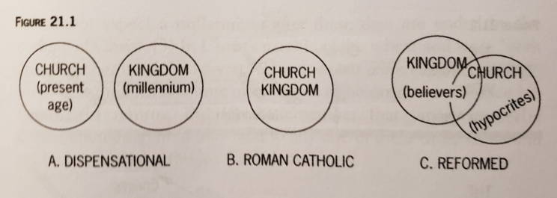
Kingdom and church

Slide 22
Kingdom and church
Christ is king and head of the church
But He is also head of the kingdom, which is larger than the church
The church has its own jurisdiction within its own boundaries, but not he secular realm
outside the church, however, each believer is directly responsible to God for working out Biblical principles in all other spheres of life
politics, education, etc.
by God's Word and Spirit
keys admit into the church, the Word into the kingdom
there can be hypocrites inside the church but outside the kingdom

Slide 23
What is a dispensation?
A dispensation is an epoch of history when the economy of salvation (i.e. how one is saved) differs
Classical dispensationalism (John Nelson Darby):
seven dispensations:
innocence
conscience
human government
promise
law
grace
the millennium

Slide 24
Dispensations - 2
Covenant theology: God establishes one single covenant with man, which develops over time
Q: What are these stages of development?
Progressive dispensationalism: influenced by covenant theology that it states that salvation is by Christ alone and grace alone
partially inconsistent
still says that Jews have their own covenant
repudiated by classical dispensationalists

Slide 25
The dispensations of human history
the 'great parenthesis'
Dispensationalism
age of innocence
eternal state
rapture
the Fall
Judgement
the LAW
church age (grace)
millennium
Q: Do we also believe in dispensations? How many are there?
Covenant theology
“I saw Satan fall like lightning from heaven." (Luke 10:18)
either in this age or in the age to come. (Mt. 12:32)
Therefore as the tares are gathered and burned in the fire, so it will be at the end of this age. (Mt. 13:40)
Garden of Eden
eternal state
the Fall
He laid hold of the dragon, that serpent of old, who is the Devil and Satan, and bound him for a thousand years (Rev. 20:2)
no rapture
Judgement
millennium
church age

Slide 26
God acting in history
The Reformation
Defeating the Spanish Armada in 1588
Protecting the Pilgrims during the cold winter of 1620
The collapse of the Soviet Union and the Iron Curtain
Q: do you know any more such events?

Slide 27
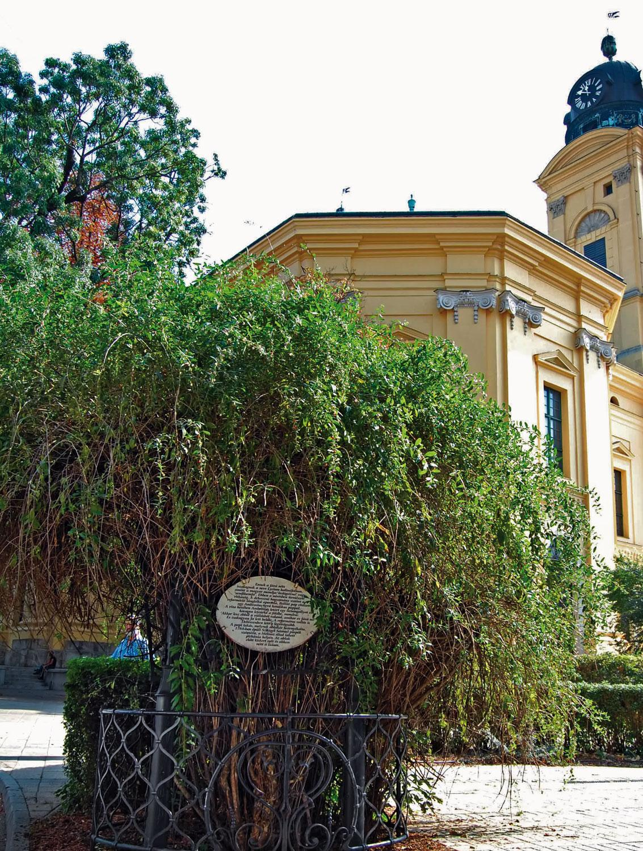
Liciumfa, Debrecen

Slide 28
Weekly Bible verse
"I found it necessary to write to you exhorting you to contend earnestly for the faith which was once for all delivered to the saints." (Jude 1:3)

